Slide 1
American Sign Language Detection
By: Abrar Altaay, Tyler Chambers, Cole Fredrick, Jaiden Hausler
Notes:
Welcome!
Today, we will be presenting you our American Sign Language Detection project.

Slide 2
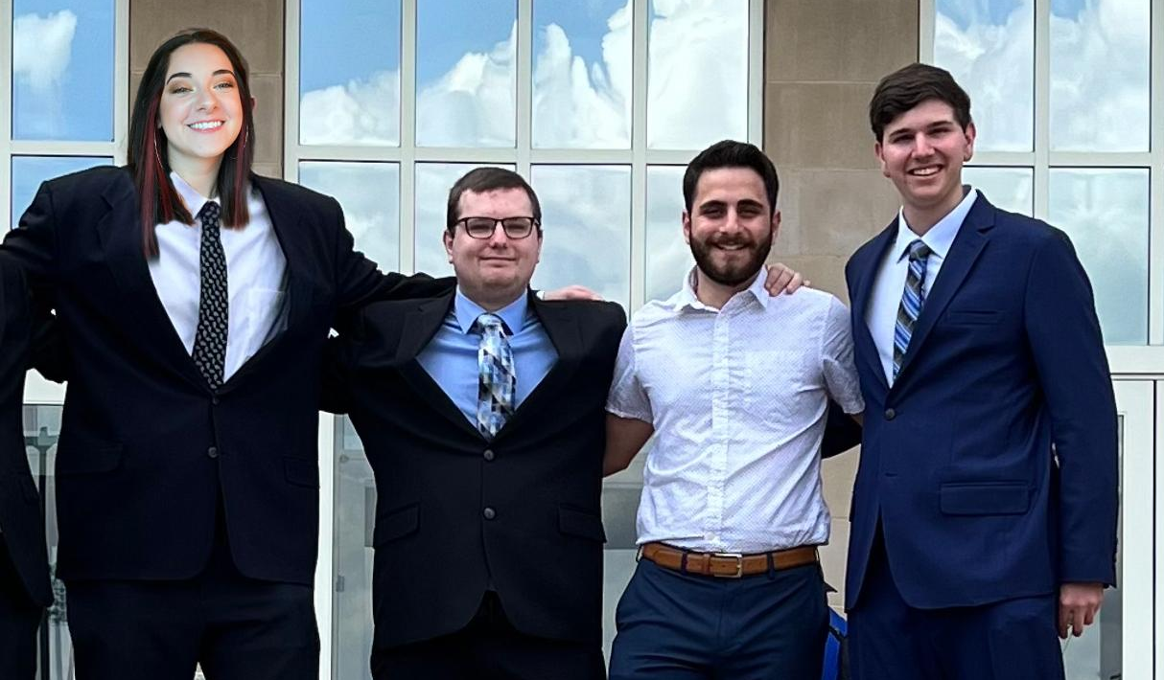
Introduction
Notes:
My name is Jaiden.
My teammates are Cole, Abrar, and Tyler.

Slide 3
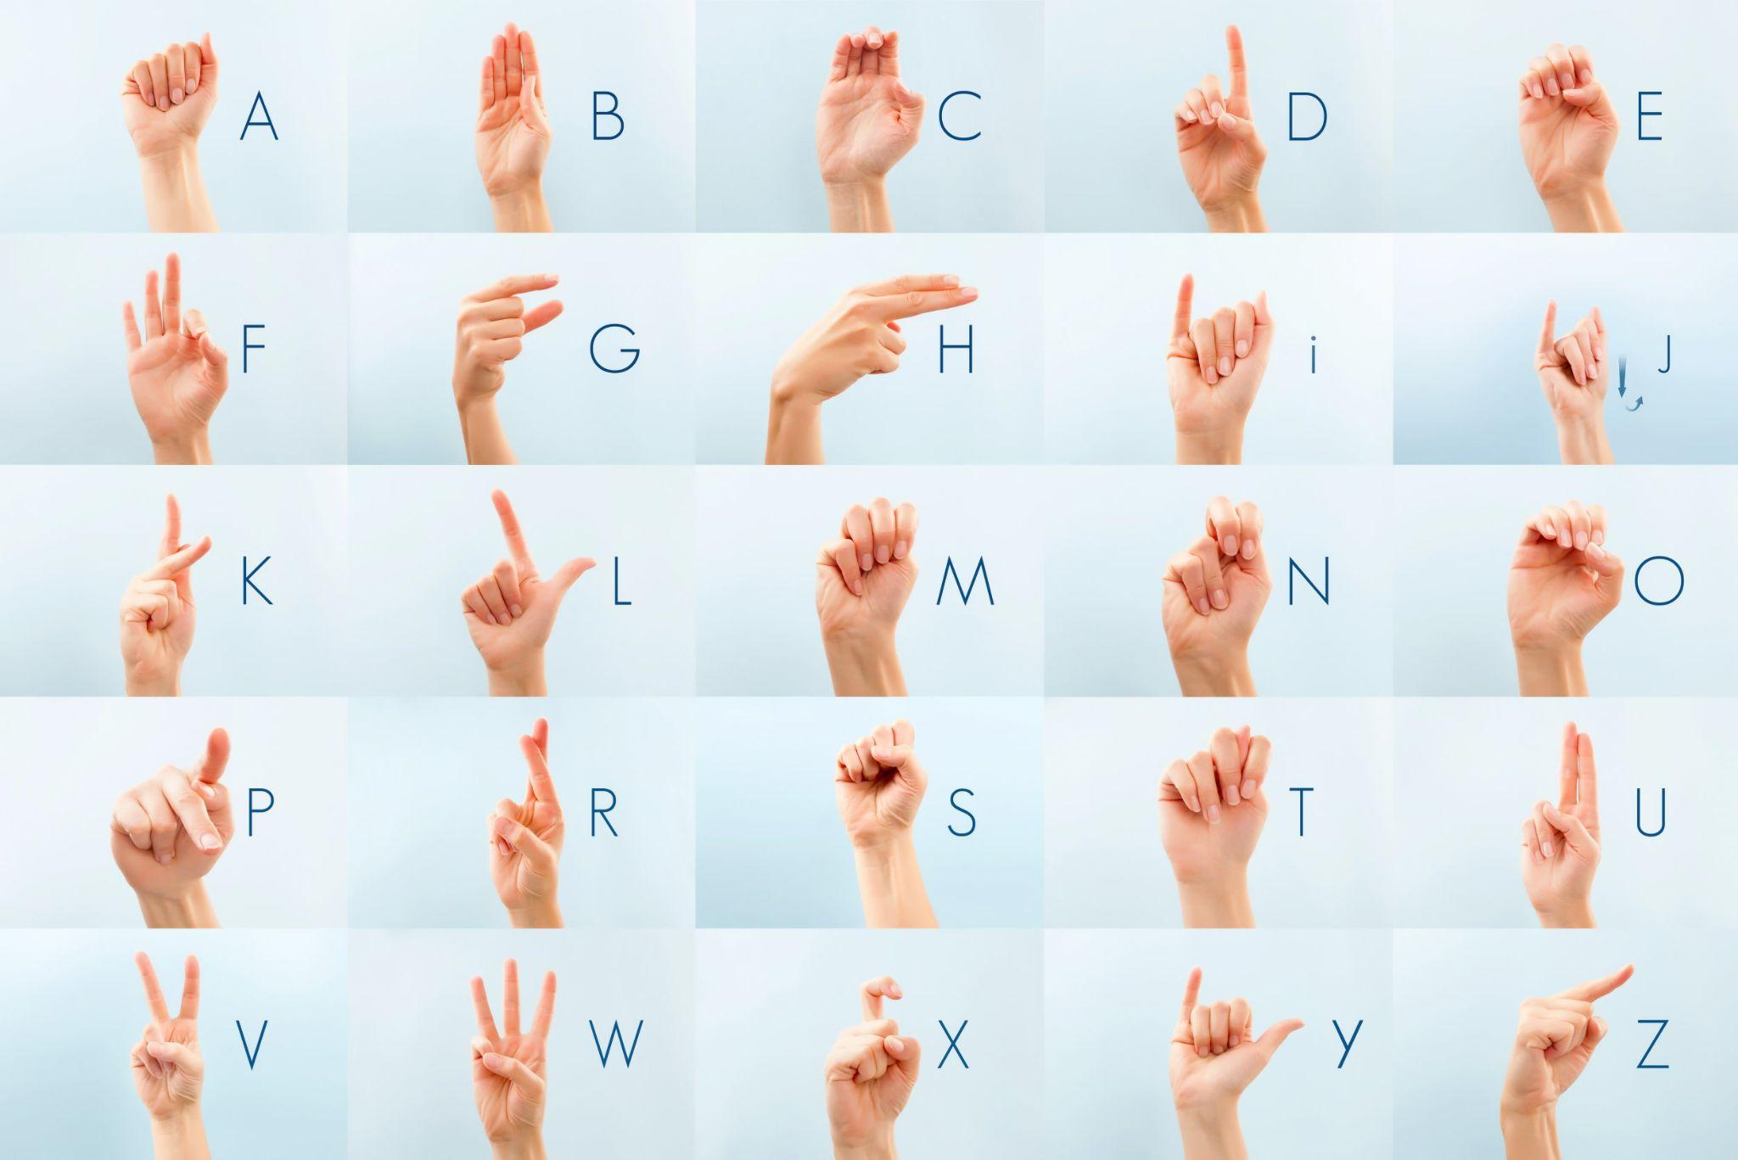
American Sign Language (ASL) Alphabet
Notes:
We focused our training on the American Sign Language Alphabet which led to 26 classes to predict. This is an example of the images similar to the ones our dataset consisted of

Slide 4
Motivation & Importance
Hearing and ASL Statistics
48 Million Americans with Hearing Issues/Loss (~14% total pop)
37.5 ( ~ 78%) million of this 48 are 18 +
30 million (62.5 %) of the americans with hearing issues can't hear out of both ears.
1% or roughly 500,000 out of the 48 million use American Sign Language
Our Goal:
Help the efforts in establishing communication between those who know and can only speak with American Sign Language and those who have no experience with it at all.
How:
Researching and applying machine learning approaches to help develop translation applications for non-ASL users.
Notes:
The biggest motivation to training this model is because of the language barrier between ASL users and non-ASL users.
48 Million Americans have hearing issues or hearing loss. 30 million of those people are affected in both ears. Yet, only 1% of those with hearing issues or hearing loss use ASL. This leaves majority of Americans unfamiliar with ASL and could discourage people who are hard of hearing from relying on this form of communication.
Our goal is to increase accessibility by establishing an easier translation process.
We accomplished this by using machine learning approaches to develop communication applications for non-ASL users to understand Sign Language.

Slide 5
Data Set
ResNet-18 & DenseNet-161: ASL (American Sign Language) Alphabet Dataset
Author: Debashis Sau (Kaggle)
Storage Size: 4.24Gb
Raw Image Resolution: 640 x 480
Pre-Processed Image Resolution: 64 x 64
Total Images: 223,075
Training: 178,459 (~80%)
Validation: 44,615 (~20%)
YoloV4 - American Sign Language Letters Dataset (Modified)
Author: David Lee (Roboflow)
Storage Size: 21.7 Mb Raw Image Resolution: 416 x 416
Pre-processed Image Resolution: Varies due to YoloV4
Total Images: 4,716
Training: 4,500 (Originally 1512) (~95%)
Validation: 144 (3%)
Testing: 72 (2%)
Notes:
Thank you Jaiden.
To tackle our objective, we’ve chosen two data sets. One that supports our ResNet-18 and DenseNet-161 Architectures and another for our YoloV4 implementation.
The first data set was published by Debashis Sau on Kaggle with a total storage size of 4.24Gb. Each image within this dataset carries raw RGB image resolutions of 640x480 with the pre-processed resolutions finalizing at 64 x 64. The total amount of images within this data set is 223,075 with the training data set and validation set being an 80% and 20% split respectively. Albeit may that the data set is rather sizeable, it was chosen mainly for the uniqueness per image and the different variations in which each character was represented.
The second data set was published by David Lee on Roboflow with a smaller storage size of 21.7Mb. Each RGB image at Raw carries a 416 x 416 resolution with the preprocessed resolutions varying anywhere from 320 x 320 to 608 x 608.
The total amount images used is 4, 716 with the training set carrying 95% of the images, the validation carrying 3%, and the test carrying 2%. From what we found, there were very few pre-built data sets that followed exactly what we needed for an implementation involving ASL. David’s explicitly carried a text file per each image that carried four values to define the bounding box coordinates and one to carry the label.
Now to explain our approach of implementation.

Slide 6
Approach
Models Used:
18 - Layer ResNet Architecture (Primary)
Number of Parameters: 11,174,000
Reason:
Faster Training times
Less Parameters
161 - DenseNet Architecture
Number of Parameters: 28,681,000
Reason:
Comparative analysis against ResNet
YoloV4 Architecture
Number of Parameters: ~60,000,000+
Reason:
Real-Time object detection
Notes:
Our approach revolves around 3 models that I mentioned on the previous slide. To start, we used a 18 Layer ResNet Architecture. It carries a parameter amount totaling roughly 11.2 million. We used this CNN as our primary classification model as it is really lightweight and efficient with training times.
In order to analyze our primary further, we chose to do comparative analysis against ResNet-18 using a 161- Layer DenseNet Architecture. The DenseNet Architecture carries roughly 28.7 Million parameters and carries a higher limit of model complexity & demands more resources from the GPU compared to our ResNet choice.
Lastly, we chose to use a YoloV4 Architecture implementation, carrying a total parameter amount roughly above 60 million and is being used strictly for real-time object detection which we will showcase later in the presentation.
I’ll toss the panel to Tyler to talk about our training setup.

Slide 7
Training Setup (ResNet - 18)
Trained on: Google Colab GPU
Transformation:
Resized 64x64
Normalized Data
Imported Untrained ResNet 18 model
Training Loop Information:
Iteration Amount: 10 Epochs
Batch size: 256
Optimizer: Stochastic Gradient Descent
Loss Function: Cross Entropy
Learning Rate: .01
Training Time (Total) : 1hr 12 min
Notes:
Thank you Cole. All of the models were trained on GPU’s provided by google colab. To train ResNet-18, the first step is to load the data and resize it to an appropriate size. 64x64 pixels for each image allowed for low training times while keeping enough data for accurate training. The images then needed to be normalized using the mean and standard deviation of the entire dataset. ResNet-18 was imported as an untrained model and was then trained on 10 epoch’s with a batch size of 256. The optimizer used was SGD and cross entropy loss function was used to calculate the loss of training and validation. The time to train sat just under an hour and fifteen minutes.

Slide 8
Training Setup (DenseNet - 161)
Trained on: Google Colab GPU
Transformation:
Resized 64x64
Normalized Data
Imported Untrained DenseNet model
Training Loop Information:
Iteration Amount: 20 Epochs
Batch size: 256
Optimizer: Stochastic Gradient Descent
Loss Function: Cross Entropy
Learning Rate: .01
Training Time (Total) : 3hr 15 min
Notes:
As done with ResNet, the data trained on DenseNet was preprocessed similarly with 64x64 pixel input images. DenseNet was trained on double the epochs as ResNet with the same batch size and loss function. The training time, however, took over double the amount of time at almost 3 and a half hours. This is due to the increase in number of epochs as well as the increase in computation requirements that the 161 layer DenseNet model needed for training.

Slide 9
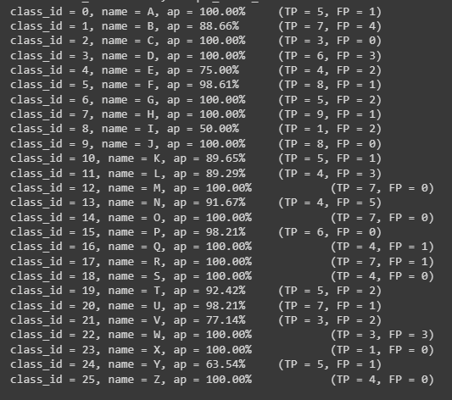
Training Setup (Yolo V4)
Trained On: Google Colab GPU
Transformation:
Resize is variable across training
Rotation of +-5°
Imported Untrained (DarkNet) model
Training Loop Information:
2125 Iterations
Batch size: 64
Learning Rate: started at 0.001 and decreased throughout training
Training Time (Total) : 2 hours 33 minutes
Notes:
Finally, the most important model trained is YoloV4. The data was augmented with rotations of 5 degrees in each direction. The image input sizes were varied during training which is a special feature of YoloV4. The model was trained on 2125 iterations with a batch size of 64 and learning rates decreasing throughout the training. The total training time sat around 2 and a half hours. You can see in the image, the average precision is very high for each letter. I’ll now pass it to Abrar to further discuss the results of each model.

Slide 10
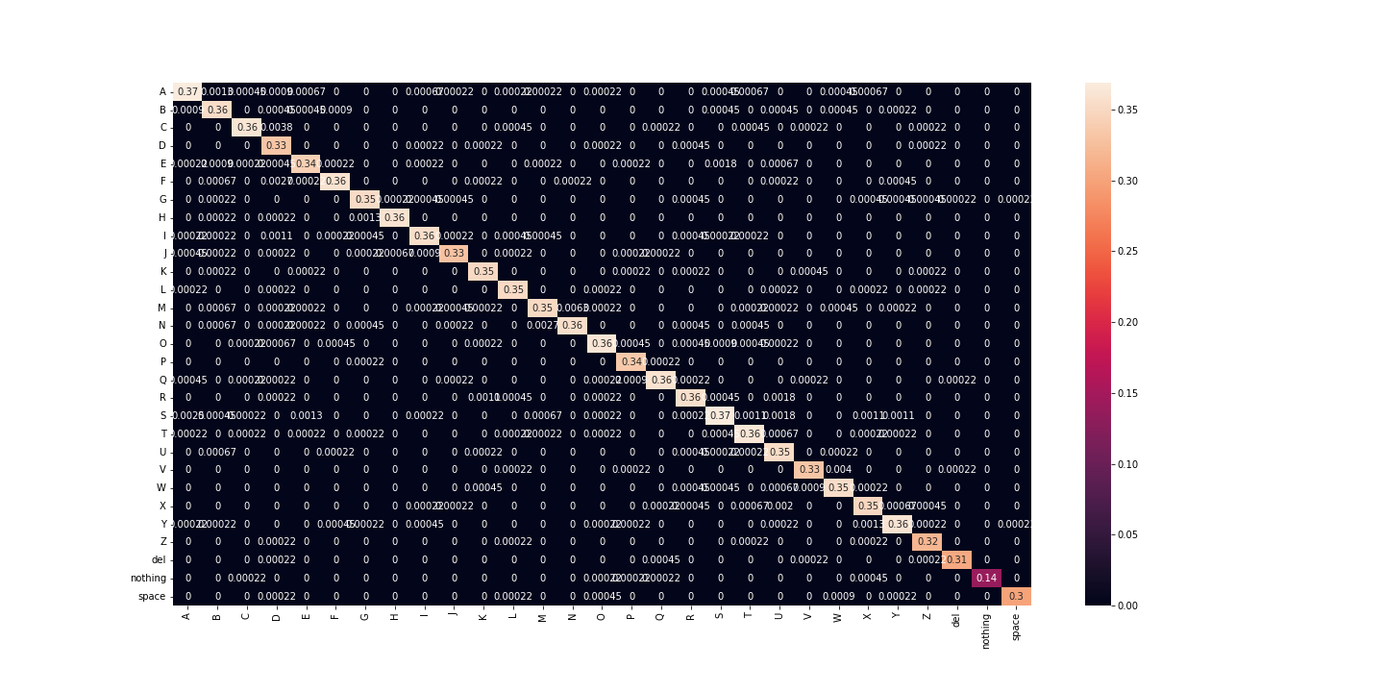
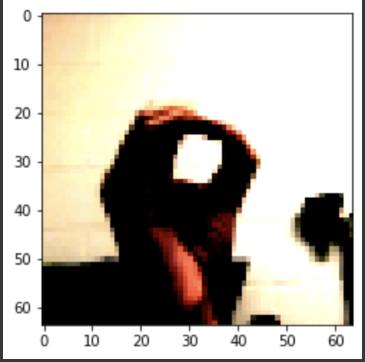
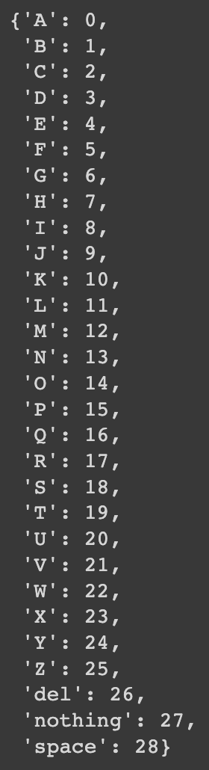

Results (Resnet-18)
Confusion Matrix ResNet-18
99% Validation Accuracy
97% Test Accuracy
Actual Labels
Predicted Labels
Notes:
Thank you Tyler,
The test accuracy were fatanstics for Resnet-18 with a respective low training time. We were able to achieve a 99% Validation Accuracy, and a 97% Test Accuracy.
We inputted an image we took ourselves of the letter O to test the accuracy of the model, and the model correctly predicted the image with an ID #14 which is the letter O as you can see in the red box
As you can see the in the confusion Matrix in the top right corner, we can see the Actual vs Predicted values show great results and accuracy per letter which validates our accuracy across the entire dataset.
Y-axis - Actually
X- asis - what the model Predicted
One of our own pictures holding the letter O in ASL
You can see that the model correctly predicted ID #14 which corresponds to the letter O
The confusion matrix in the top right shows how much the accuracy per letter.
This validates our accuracy across the data set.

Slide 11
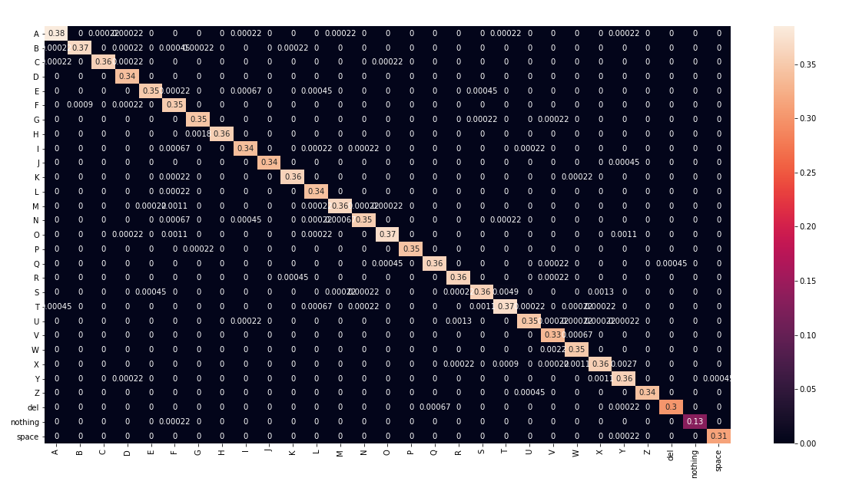
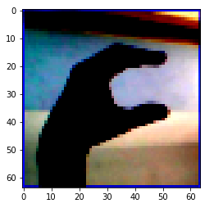
Results (DenseNet-161)
Confusion Matrix DenseNet-161
99% Validation Accuracy
98% Test Accuracy
Actual Labels
Predicted Labels
Notes:
The test accuracy for DenseNet-161 was very similar to Resnet-18 with more than double the training time. We achieved a 99% Validation Accuracy, and a 98% Test Accuracy. Only a one percent difference between the two.
We inputted an image we took of the letter C to test the accuracy, where the model correctly predicted the image with an ID #02 which is the letter C as you can see again in the red box
Again, As you can see the in the confusion Matrix in the top right corner, we can see the Actual vs Predicted values show great results and accuracy per letter which validates our accuracy across the entire dataset.
Y-axis - Actually
X- asis - what the model Predicted
One of our own pictures holding the letter C in ASL
You can see that the model correctly predicted ID #02 which corresponds to the letter C
The confusion matrix in the top right shows how much the accuracy per letter.
This validates our accuracy across the data set.

Slide 12
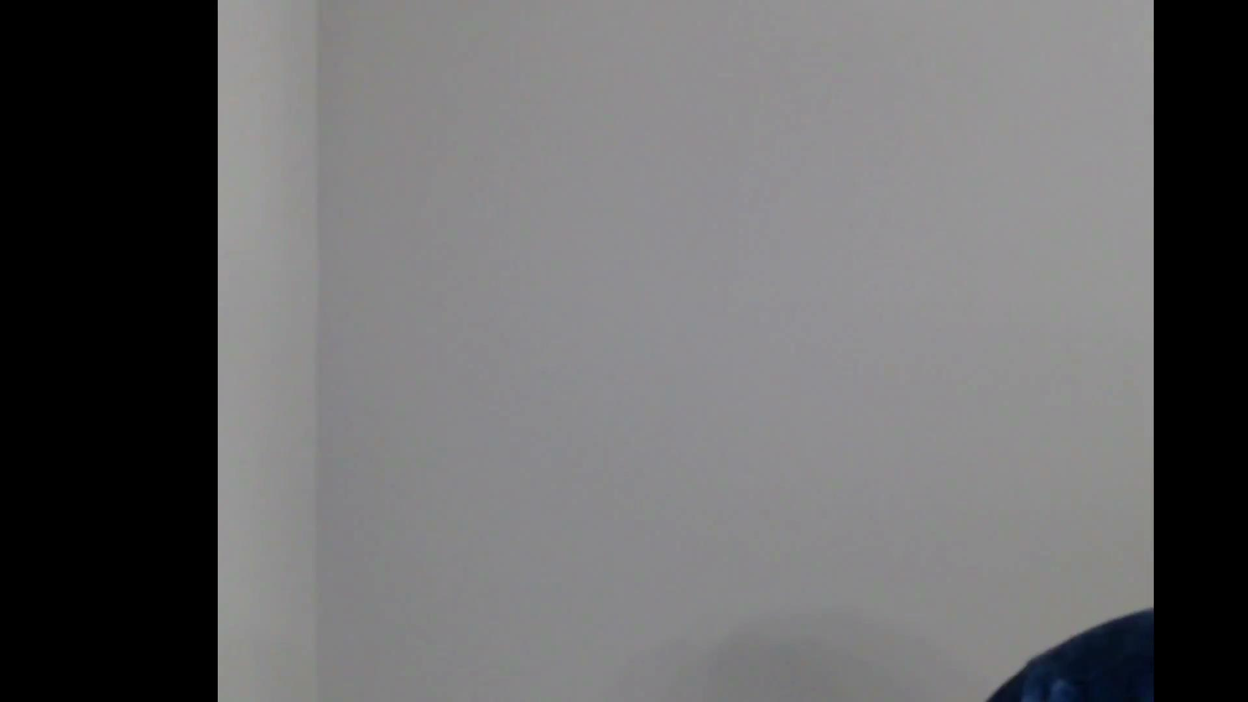
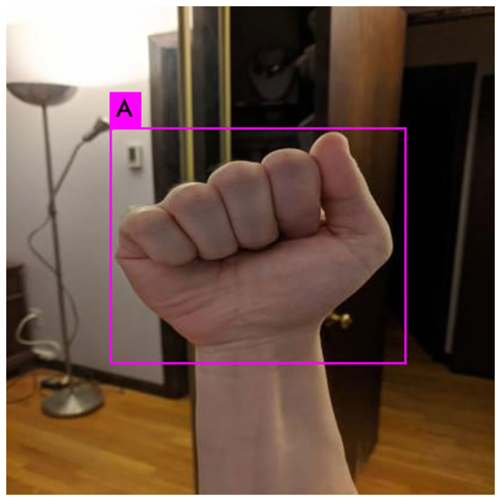
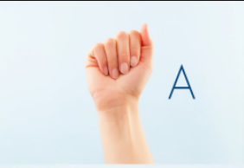

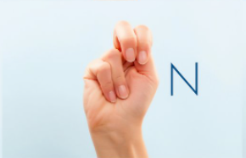
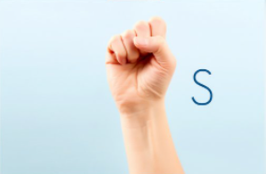
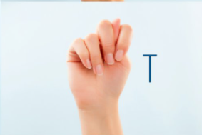
Results (YoloV4)
93% Test Accuracy
Processed video at 30 average FPS
Notes:
When Running YOLO-V4 we were able to get 93% accuracy. And we were able to process videos at around 30 frames per second.
While testing, we noticed that the model performs best when the video just showed the users hand gestures and close to the camera with no face visible.
Currently, there are around 4 letters that the model has difficulties recognizing. The letters being A, M, N, S, and T. These letter gestures look extremely similar to one another, the difference is the placement of the thumb which determines the letter.
The main reason is because the data set does not include a large number of images for the network to be trained and we believe if the set was increased this issue would be minimized.
As you see in the video, the model is able to successfully draw bounding boxes around my hand and accurately predict the letter I was gesturing. At times you can see multiple bounding boxes for a certain letter, again this is usually because that certain letter might look especially similar to another letter being predicted.

Slide 13
Lessons Learned / Problems
Key Problems:
Originally had issues with training on the ASL labels for ResNet
Fine tuning the number of Epoch’s to prevent overfitting for ResNet and DenseNet
Colab GPU memory issues DenseNet-161
Lessons Learned:
Implementing YoloV4 for custom datasets
Importing Pytorch Models
More in depth knowledge of YoloV4
Notes:
Thank you Abrar.
Overall the experience has been very rewarding as the amount of things learned over the course of its progression are tremendous. Although tremendous, it certainly had its issues, with one of the key problems being centered around training issues on the ASL labels for ResNet.
Another problem we found was varying the amount of Epoch’s we used to prevent overfitting for ResNet and DenseNet as it was certainly a challenge. As we showcased before, we never went over an epoch total of 20, this was due to the fact that at any higher than ten for ResNet the overfitting would exponentially increase and for DenseNet we were allowed to go up to double that of ResNet but anything higher than twenty would lead into the same result as the previous.
Lastly, we ran into several issues with adjusting the image & batch sizes for DenseNet - 161. When training on values that were too high we ran into GPU memory issues with colab. We were quickly able to fix this by preprocessing the images to 64x64 and adjusting the batch size to 256.
I’ll move the panel to Jaiden for the conclusion.

Slide 14
Conclusion
ResNet-18 VS DenseNet-161
ResNet-18 took 2hr 3min less time to train
Less computational power
Similar test accuracies
ResNet-18: 97%
DenseNet-161: 98%
ResNet-18 is preferred for optimization
DenseNet preferred for max accuracy
Not concerned about computational power
Yolo v4
Could use improvements on deciphering between a, m, n, s, t
Able to predict the rest of the alphabet efficiently
Notes:
Just to recap on our results, when you compare ResNet-18 to DenseNet-161, ResNet took 2hr and 3min less time to train meaning it takes less computational power. Even with this, the two models resulted in 1% difference of test accuracy. That being said, we recommend ResNet-18 because of it’s optimization in training time. If you were trying to maximize the most accuracy and you are not concerned about computational power then you could use DenseNet as a good alternative.
Yolo v4 could use improvements on deciphering between a, m, n, s, t and we suggest more images in the training. But YoloV4 is able to predict the rest of the alphabet efficiently and is a good use of real-time ASL alphabet translation.

Slide 15
References
https://public.roboflow.com/object-detection/american-sign-language-letters (Yolo V4 Dataset)
https://www.kaggle.com/datasets/debashishsau/aslamerican-sign-language-aplhabet-dataset (ResNet & DenseNet Dataset)
https://www.hearingloss.org/wp-content/uploads/HLAA_HearingLoss_Facts_Statistics.pdf (Hearing Loss Statistics)
https://www.nidcd.nih.gov/health/statistics/quick-statistics-hearing (Hearing Loss Statistics)
https://www.gallaudet.edu/documents/Research-Support-and-International-Affairs/ASL_Users.pdf (ASL Statistics)
https://www.ilovelanguages.com/how-many-people-use-sign-language-worldwide/ (ASL Statistics)
Notes:
These are our references

Slide 16
Questions?
Notes:
Any questions?

